Slide 1

Portfolio optimization (Modern Portfolio Theory)
St. Xavier’s College (Autonomous), Ahmedabad
M. Sc. Big Data Analytics
Name: Divyakumar A. Kotia
Roll no. : 23-PBD-010
Paper name: Statistical Methods
Paper code: PBD-1801

Slide 2
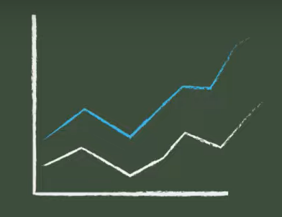
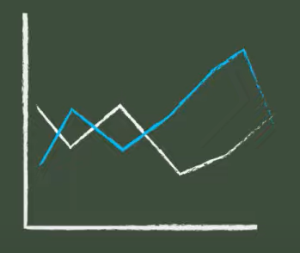
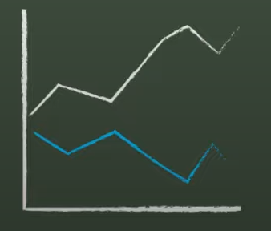

Overview
Covariance
Relationship
between
two variables
$Cov\left(X, Y\right)= \frac{Σ (x_{i}−\overline{x})(y_{i}−\overline{y})}{n}$
Positive relationship
Negative relationship
No relationship
fig 1. Graphical representation of covariance
Image courtesy: Finance Explained. (2022, August 3). Markowitz Model and Modern Portfolio Theory – Explained [Video]. YouTube. https://www.youtube.com/watch?v=VsMpw-qnPZY

Slide 3
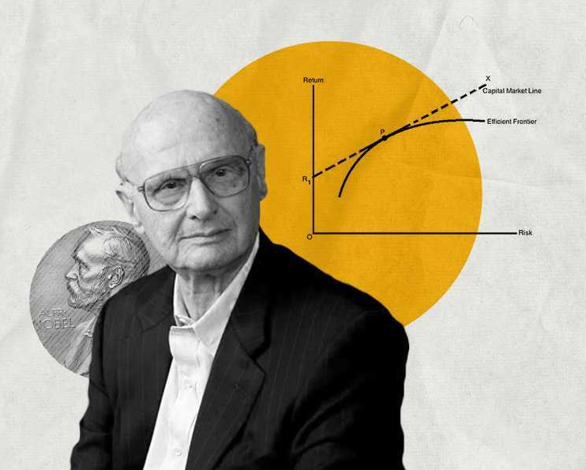
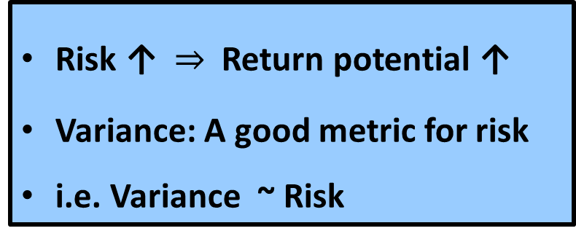
Modern Portfolio Theory (MPT)
Risk ↑ Return potential ↑
Variance: A good metric for risk
i.e. Variance ~ Risk
Harry Markowitz
MPT: The modern portfolio theory (MPT) is a practical method for selecting investments in order to maximize their overall returns within an acceptable level of risk.
Image Courtesy: https://finshots.in/archive/what-is-modern-portfolio-theory/

Slide 4
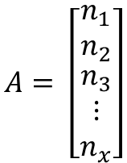
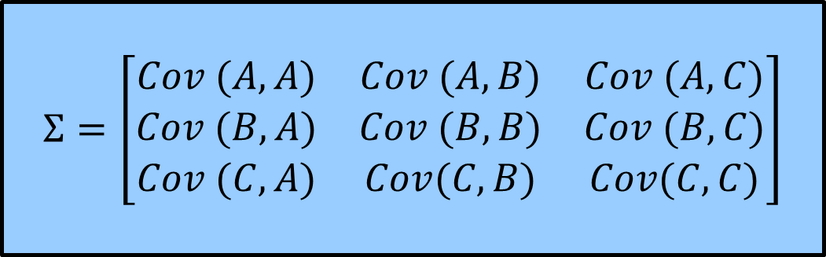
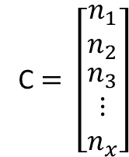
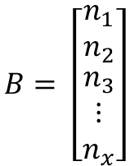
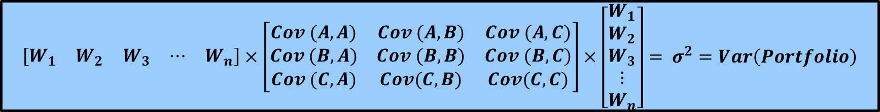

Covariance matrix ( ∑ )
Historical asset returns
$$Σ=\left[\begin{matrix}Cov (A, A) & Cov (A,B) & Cov (A,C) \\ Cov (B,A) & Cov (B,B) & Cov (B,C) \\ Cov (C,A) & Cov(C,B) & Cov(C,C)\end{matrix}\right]$$
$$A= \left[\begin{matrix}n_{1} \\ n_{2} \\ \begin{aligned}n_{3} \\ ⋮ \\ n_{x}\end{aligned}\end{matrix}\right]$$
$$B= \left[\begin{matrix}n_{1} \\ n_{2} \\ \begin{aligned}n_{3} \\ ⋮ \\ n_{x}\end{aligned}\end{matrix}\right]$$
C $= \left[\begin{matrix}n_{1} \\ n_{2} \\ \begin{aligned}n_{3} \\ ⋮ \\ n_{x}\end{aligned}\end{matrix}\right]$
Portfolio weight vector (W)
Stock 1 | Stock 2 | Stock 3 | Stock 4
50 % | 20 % | 20 % | 10 %
$$W= \left[\begin{matrix}0.5 & 0.2 & 0.2 & 0.1\end{matrix}\right]$$
$$W= \left[\begin{matrix}W_{1} & W_{2} & W_{3} & ⋯ & W_{n}\end{matrix}\right]$$
$$\left[\begin{matrix}W_{1} & W_{2} & W_{3} & ⋯ & W_{n}\end{matrix}\right]×\left[\begin{matrix}Cov (A, A) & Cov (A,B) & Cov (A,C) \\ Cov (B,A) & Cov (B,B) & Cov (B,C) \\ Cov (C,A) & Cov(C,B) & Cov(C,C)\end{matrix}\right]×\left[\begin{matrix}W_{1} \\ W_{2} \\ \begin{aligned}W_{3} \\ ⋮ \\ W_{n}\end{aligned}\end{matrix}\right]= σ^{2}=Var\left(Portfolio\right)$$
$$∴W×Σ×W^{T}= σ^{2}=Var\left(Portfolio\right)=Risk$$

Slide 5
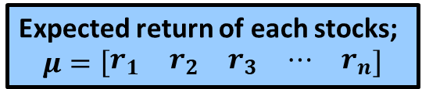
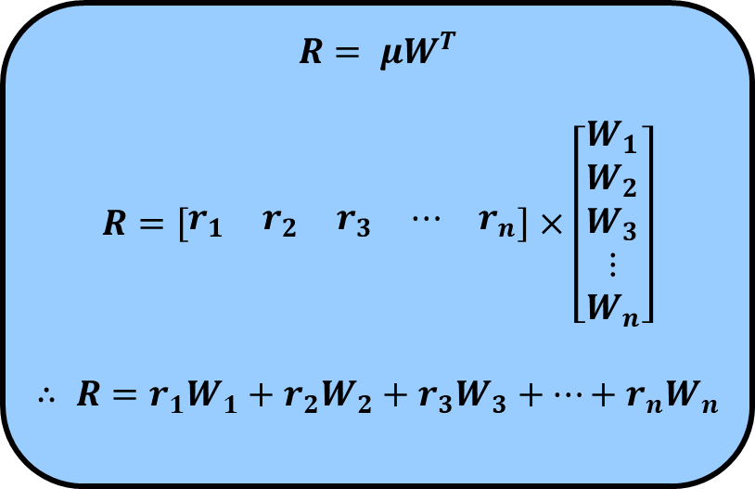
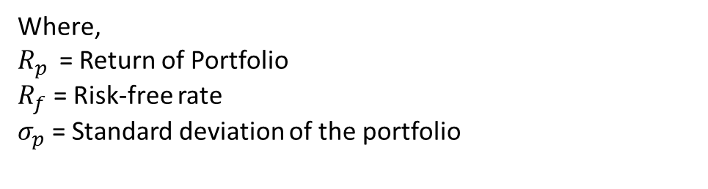

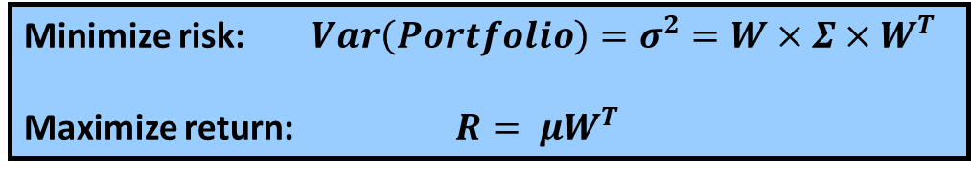
Objective
Expected Portfolio Return (R)
Minimize risk: $Var\left(Portfolio\right)=σ^{2}=W×Σ×W^{T}$
Maximize return: $R= μW^{T}$
Expected return of each stocks;
$$μ=\left[\begin{matrix}r_{1} & r_{2} & r_{3} & ⋯ & r_{n}\end{matrix}\right]$$
Can be achieved by making proper selection of weights of the stocks (as it is the common parameter in both the Risk and the Return)
$$R= μW^{T}$$
$$R=\left[\begin{matrix}r_{1} & r_{2} & r_{3} & ⋯ & r_{n}\end{matrix}\right]×\left[\begin{matrix}W_{1} \\ W_{2} \\ \begin{aligned}W_{3} \\ ⋮ \\ W_{n}\end{aligned}\end{matrix}\right]$$
$$∴ R=r_{1}W_{1}+r_{2}W_{2}+r_{3}W_{3}+⋯+r_{n}W_{n}$$
Sharpe ratio
Sharpe ratio = $\frac{R_{p }− R_{f}}{σ_{p}}$
a way to measure the risk-adjusted returns of your investments
Where,
$R_{p }$ = Return of Portfolio
$R_{f}$ = Risk-free rate
$σ_{p}$ = Standard deviation of the portfolio

Slide 6
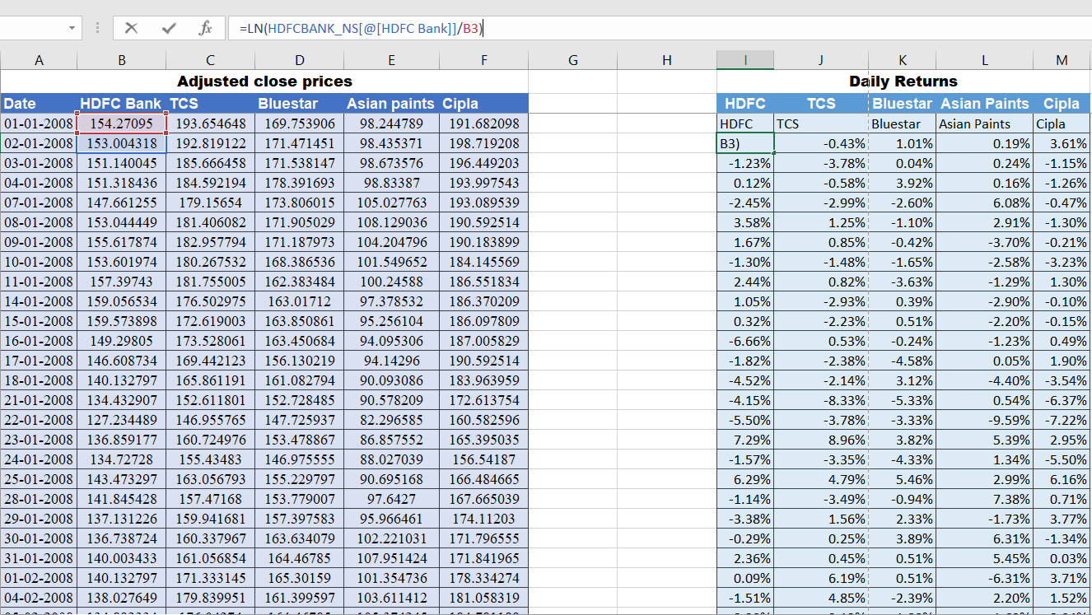
Implementation
fig 2. Historical data and daily returns

Slide 7
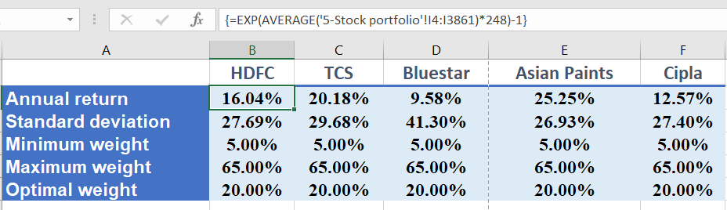
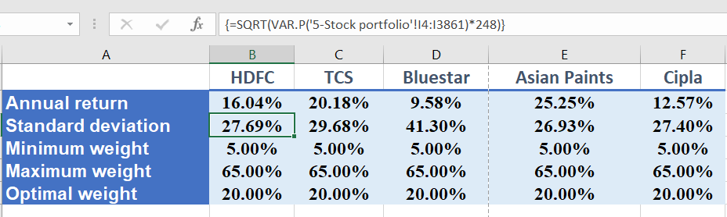
Implementation
fig 3. Average annual return of each stocks
fig 4. Average annual Standard deviation of each stocks

Slide 8
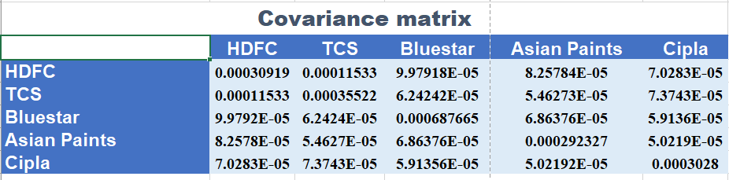
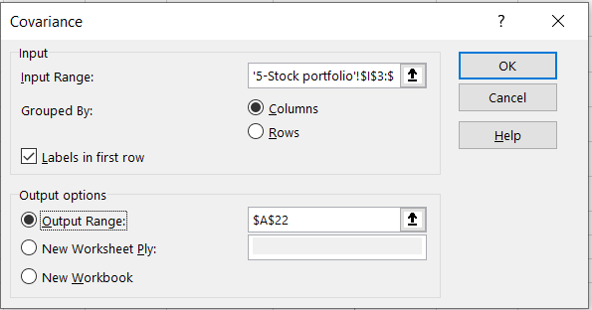
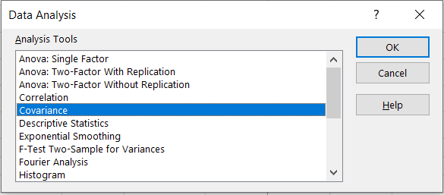
Implementation
fig 5. Covariance matrix
fig 6. Data Analysis tool box

Slide 9
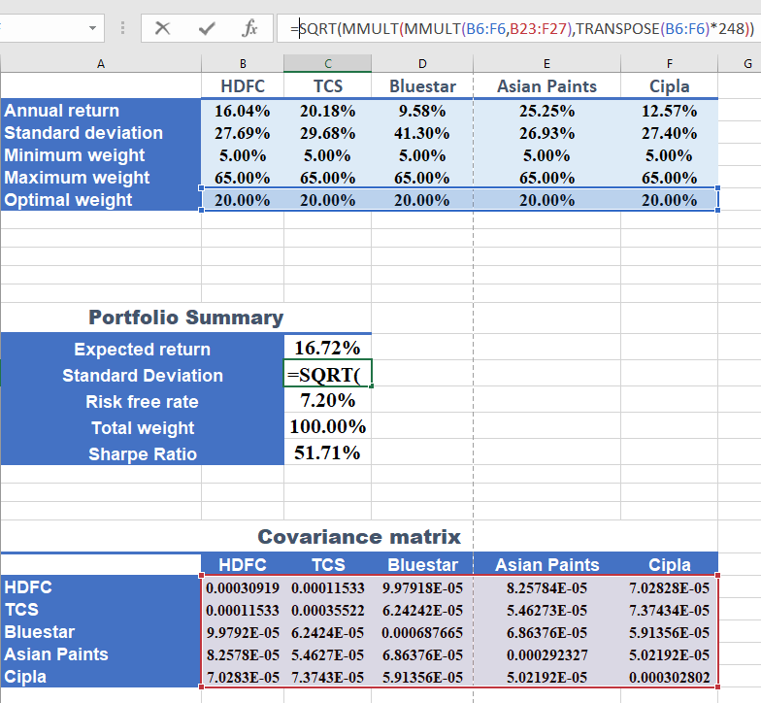
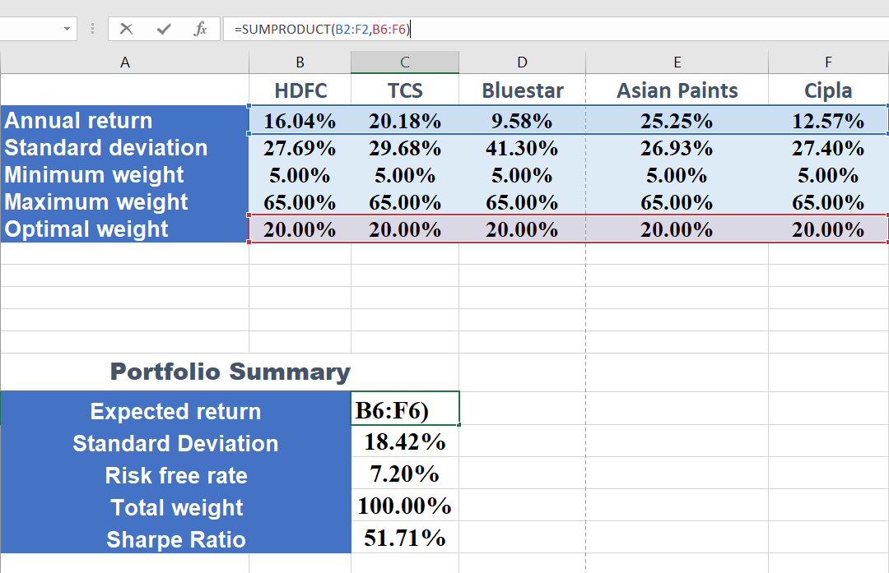
Implementation
fig 7. Expected portfolio return
fig 8. Portfolio Standard deviation

Slide 10
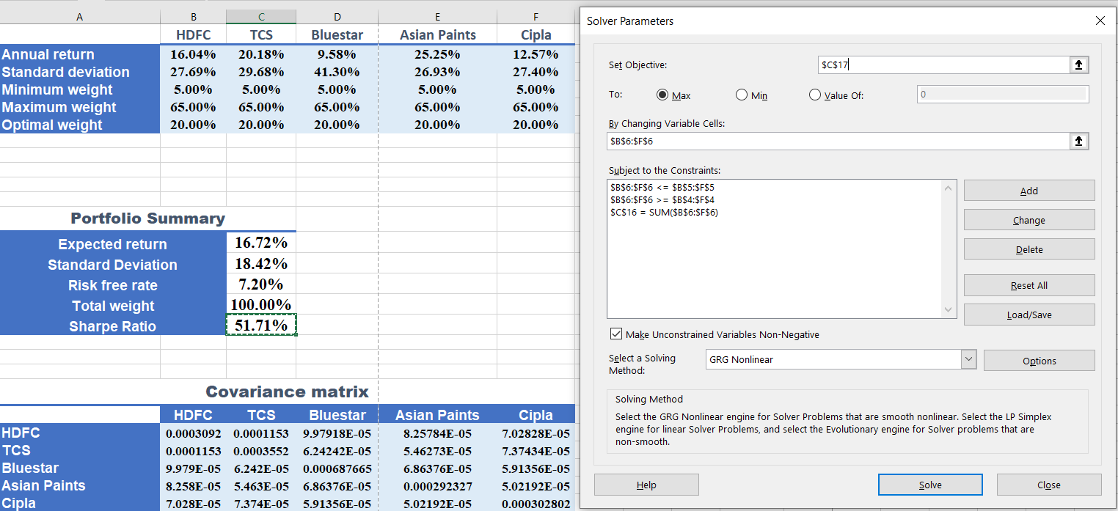
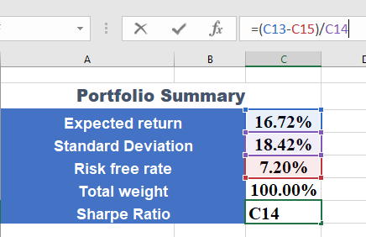
Implementation
fig 9. Sharpe ratio
fig 10. Optimizing Sharpe ratio using solver

Slide 11
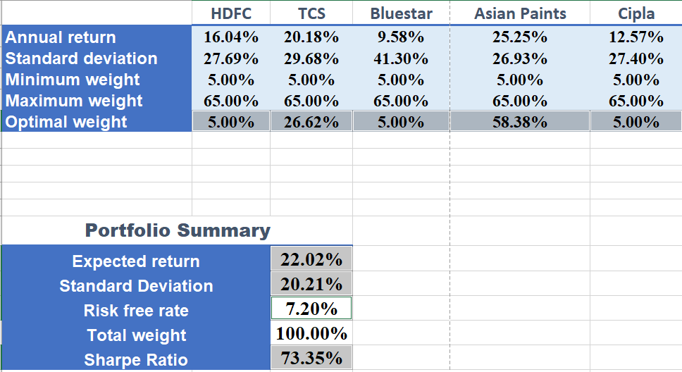
Implementation
fig 11. Optimization result with constraints set to weights

Slide 12
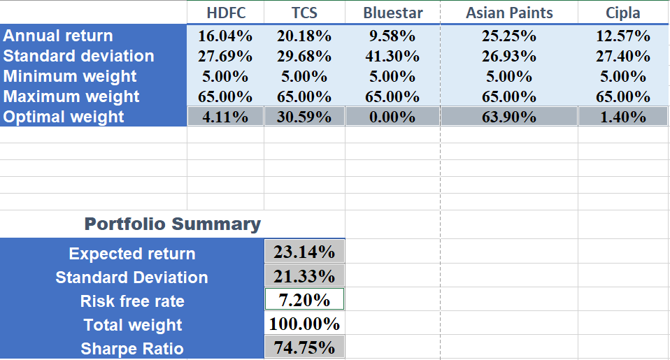
Implementation
fig 11.2 Optimization results without constraints to weights

Slide 13
THANK YOU !!
A good portfolio is more than a long list of good stocks and bonds. It is a balanced whole, providing the investor with protections and opportunities with respect to a wide range of contingencies.
- Harry Markowitz

